Slide 1
Navigating New York: A Deep Dive into Taxi Journeys
PROJECT: 2
Chandrakanth Naidu Gonuguntla

Slide 2
This data contains 20,000 rows and 17 columns.
The data include fields capturing pick-up and drop-off dates/times, pick-up and drop-off locations, trip distances and driver-reported passenger counts.
The data is collected and provided to the NYC Taxi and Limousine Commission (TLC) by technology providers authorized under the Taxicab & Livery Passenger Enhancement Programs (TPEP/LPEP).
This is real time data and I collected this from below link.
This data depicts details about taxi activities during the month of May in 2013 within New York City.
Data: https://data.cityofnewyork.us/Transportation/2018-Yellow-Taxi-Trip-Data/t29m-gskq
For more information please refer to http://www.nyc.gov/html/tlc/html/about/trip_record_data.shtml

Slide 3
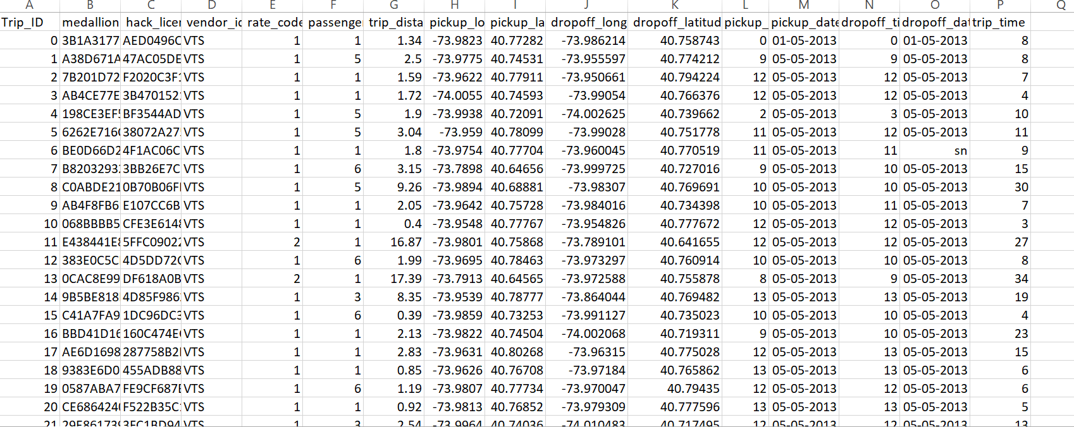
Sample data

Slide 4
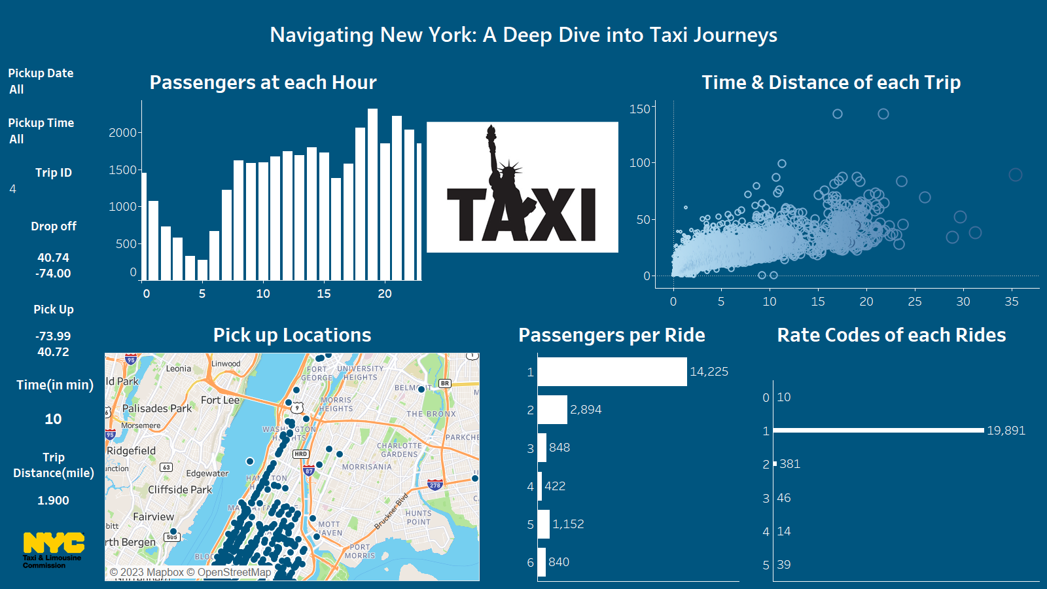

Slide 5
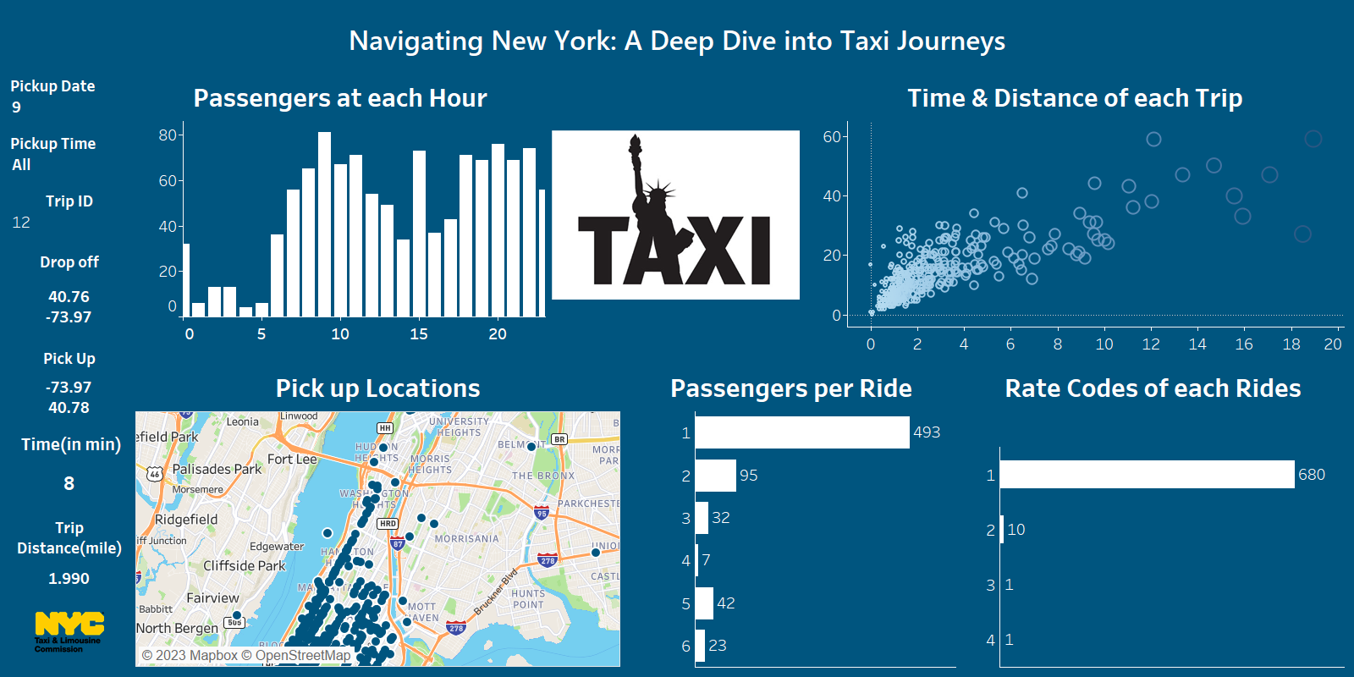

Slide 6
